Slide 1
OpenHack with Red Hat & AWS

Slide 2
Team and Use Case
Team Name | Team Member Name | Mail Id | PU
Power-X | Ashutosh Kumar | Ashutosh.kumar352@Infosys.com | IVS-FS2
 | Mosses John | Mosses.john@Infosys.com | IVS-FS2
 | Abhilash Sivasanker | Abhilash.s16@Infosys.com | IVS-FS2
Process Automation | Process Automation: Design and Build a notification framework/micro service (Email/SMS) leveraging any suggested workflow automation tools. Following are few key deliverables, however scope is not limited: 1)Flexible, modular and codeless integration with any project. 2)Message Fallback, retry automation with time limits.

Slide 3
Use Case
Required an application/service which can be integrated with an existing project in order to broadcast any artifact(s) so that the concerned team members can be notified with real time notifications regarding project operations.
CONTEXT: Need of an application that facilitates codeless integration with an existing project
BUSINESS RELEVANCE: Helps in circulating real time updates throughout SDLC or STLC of a project
BUSINESS SOLUTION: PowerXNotifications (SasS)– Software as a Service that provides easy integration and flexible operation.

Slide 4
Technical Solution
Technology StacK
Amazon AWS as IaaS
EC2 compute service
S3 Storage Service
AWS SNS as notification service
RedHat OpenShift as PaaS
Why did you choose this stack?
The technology stack that we have chosen is the best fit for cloud native application.
Using AWS cloud services helps in Maintaining the availability of infrastructure and flexibility of scaling the infrastructure.
Using Openshift as PaaS eases the procedure Deployment and Operations since the container based architecture helps to run each service in isolation at the same being able to contact with the required services in the stack.
Another crucial benefit of using Openshift is easy to manage microservices in terms that we can run more than one instance of a microservice to handle the traffic better, feature like auto build, load balancing, security and real time monitoring helps in availability, scalability and maintainability of services that we may offer.

Slide 5
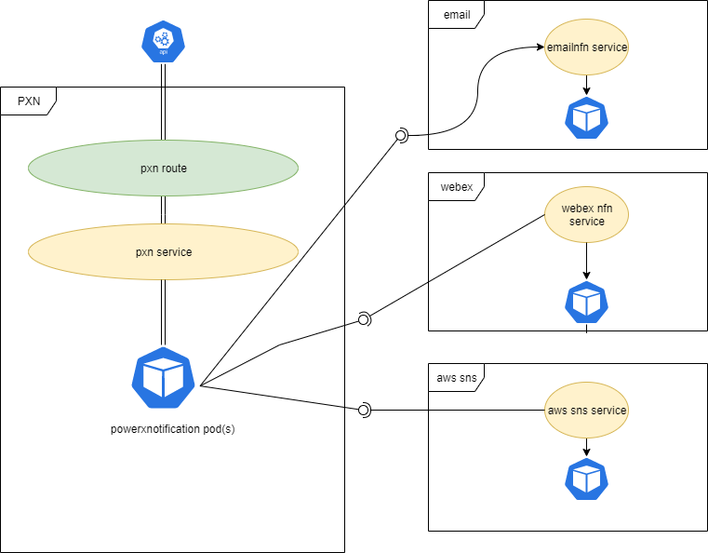
Design- Backend
Interactions among microservices

Slide 6
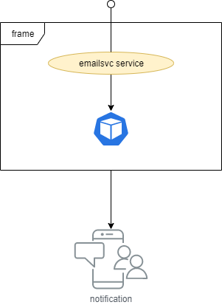
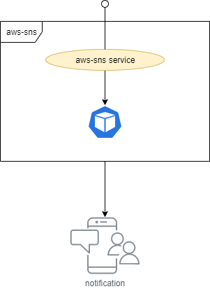

Design
Individual services

Slide 7
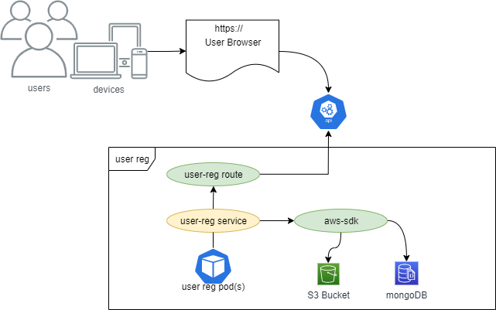
Design - FrontEnd
User Registration

Slide 8
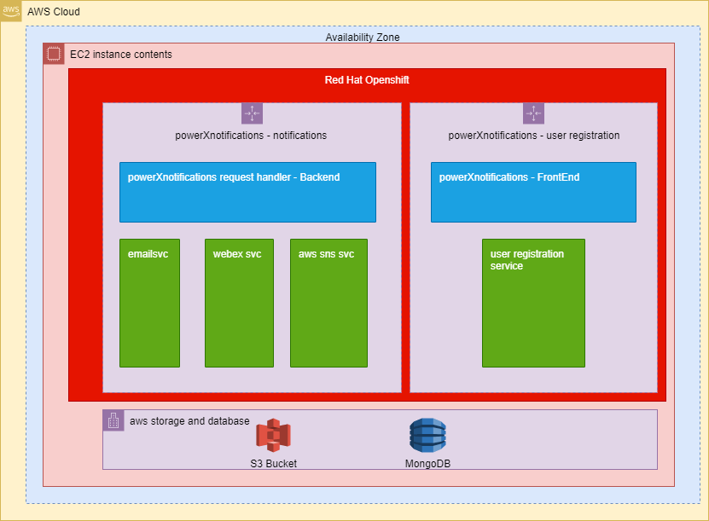
Deployment
Deployment platforms
AWS EC2 (Infrastructure)
RedHat Openshift (Platform)

Slide 9
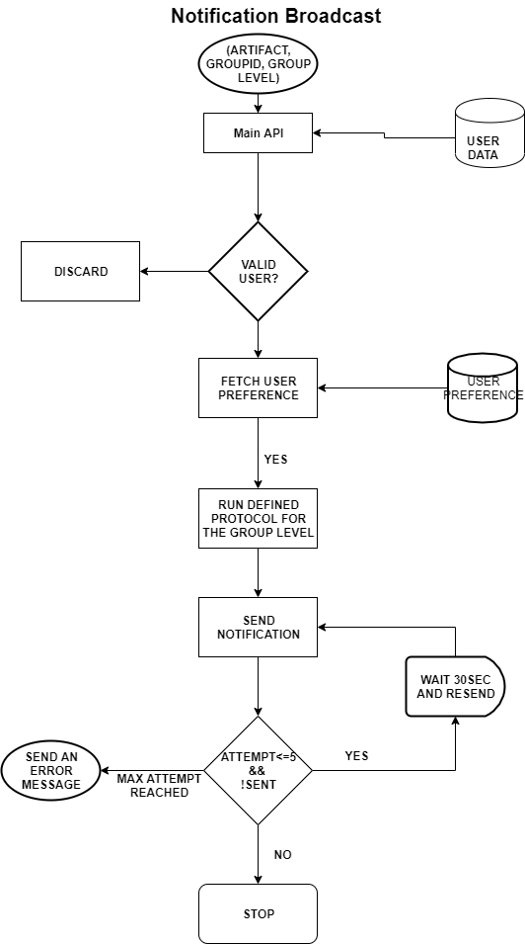
Flow diagram

Slide 10
Thank You

